Slide 1




CUSTOMER RELATIONSHIP MANAGEMENT (CRM)
Presented By:-
Vasanthi Sirikonda
Yashraj Tiwari
Kodipaika Nithin Kumar
Shashank Chakravarthi Chityala
M Laxmikanth

Slide 2
CONTENTS
CRM
E-COMMERCE CRM
OBJECTIVES
SYSTEM REQUIREMENTS
SYSTEM DESIGN SPECIFICATION
SONARQUBE REPORT
OUTPUT SCREENS
CONCLUSION
FUTURE SCOPE

Slide 3

CUSTOMER RELATIONSHIP MANAGEMENT (CRM)
Technology for managing all your company’s relationships and interactions with customers and potential customers.
A CRM system gives everyone — a better way to manage the external interactions and relationships that drive success.

Slide 4
E-COMMERCE CRM
E-Commerce CRM systems have the power to harness your data, so that you can gain insight into customer behavior, social experience and purchasing habits.​

Slide 5
OBJECTIVES
The main Objectives for our project is:-
To Create a Database and tables using MySQL.
To Use the Layered Architecture in Spring and write the backend code for it in STS (IDE).
To Create the frontend part using React in Visual Studios (IDE).
To Integrate the Frontend part and Backend part including the databases.

Slide 6
SYSTEM REQUIREMENTS
SOFTWARE REQUIREMENTS:
Java (1.8)
MYSQL (8.0.28)
Spring Boot(2.7.16)
React JS(18.2.0)
CSS
Axios
CORS
JavaScript
IDE (Eclipse, Spring STS, Visual Studio)
Server (Tomcat)
Jenkins
AWS

Slide 7
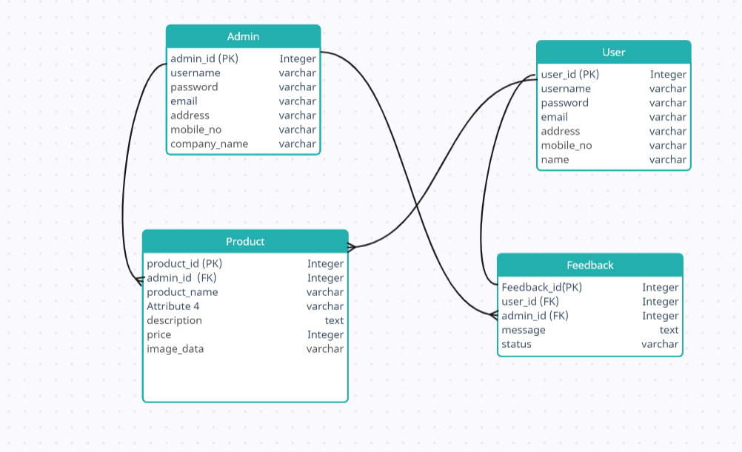
SYSTEM DESIGN SPECIFICATION
DATA FLOW DIAGRAM:

Slide 8
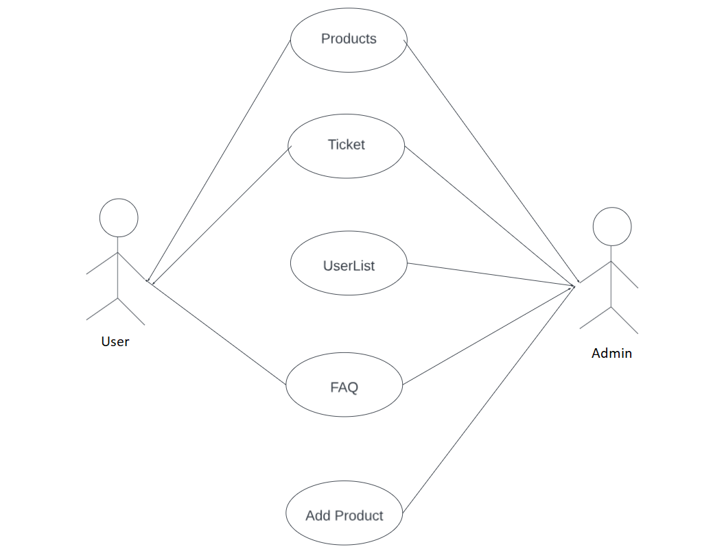
USECASE DIAGRAM

Slide 9
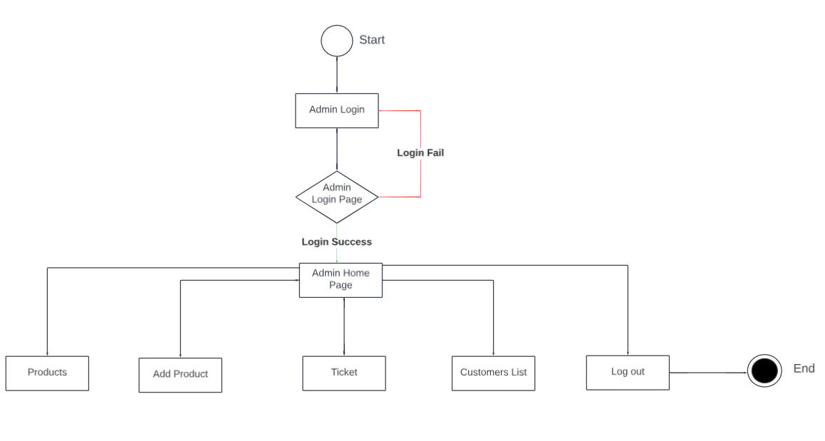
ACTIVITY DIAGRAM FOR ADMIN

Slide 10
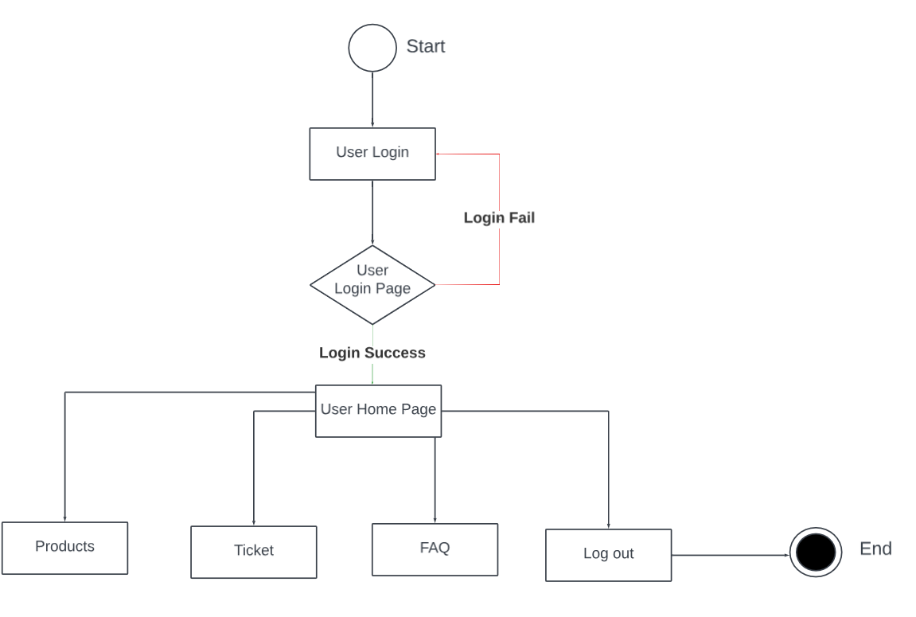
ACTIVITY DIAGRAM FOR USER

Slide 11
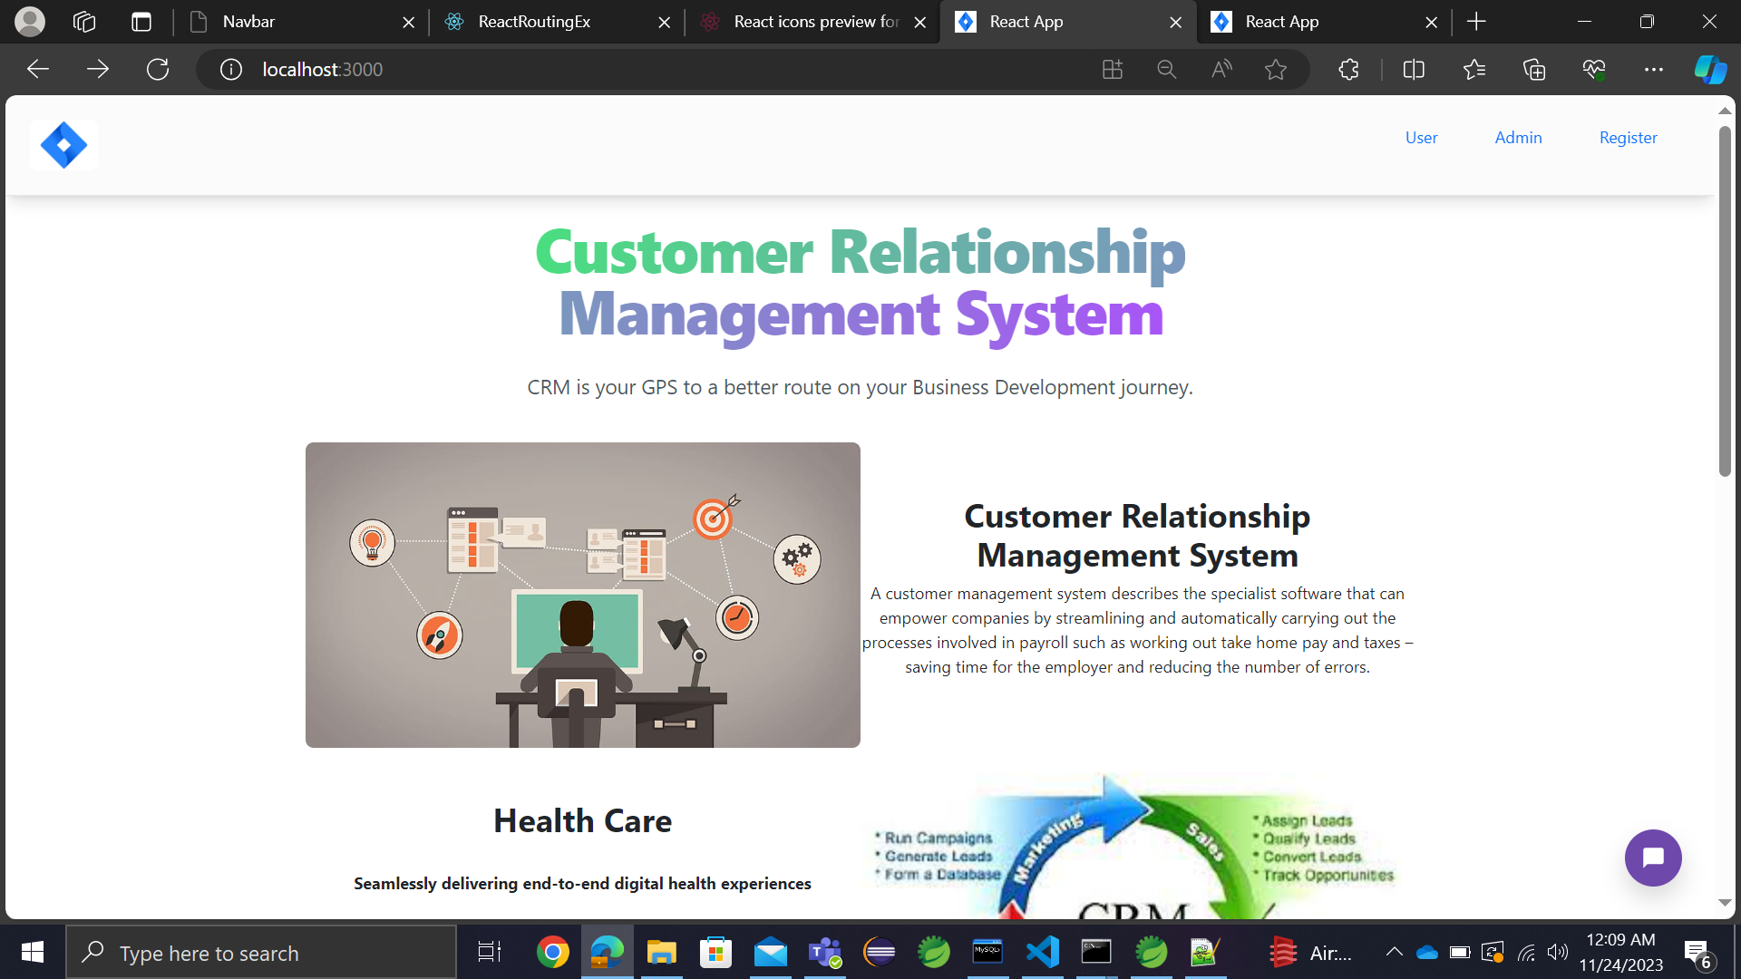
OUTPUT SCREENS

Slide 12
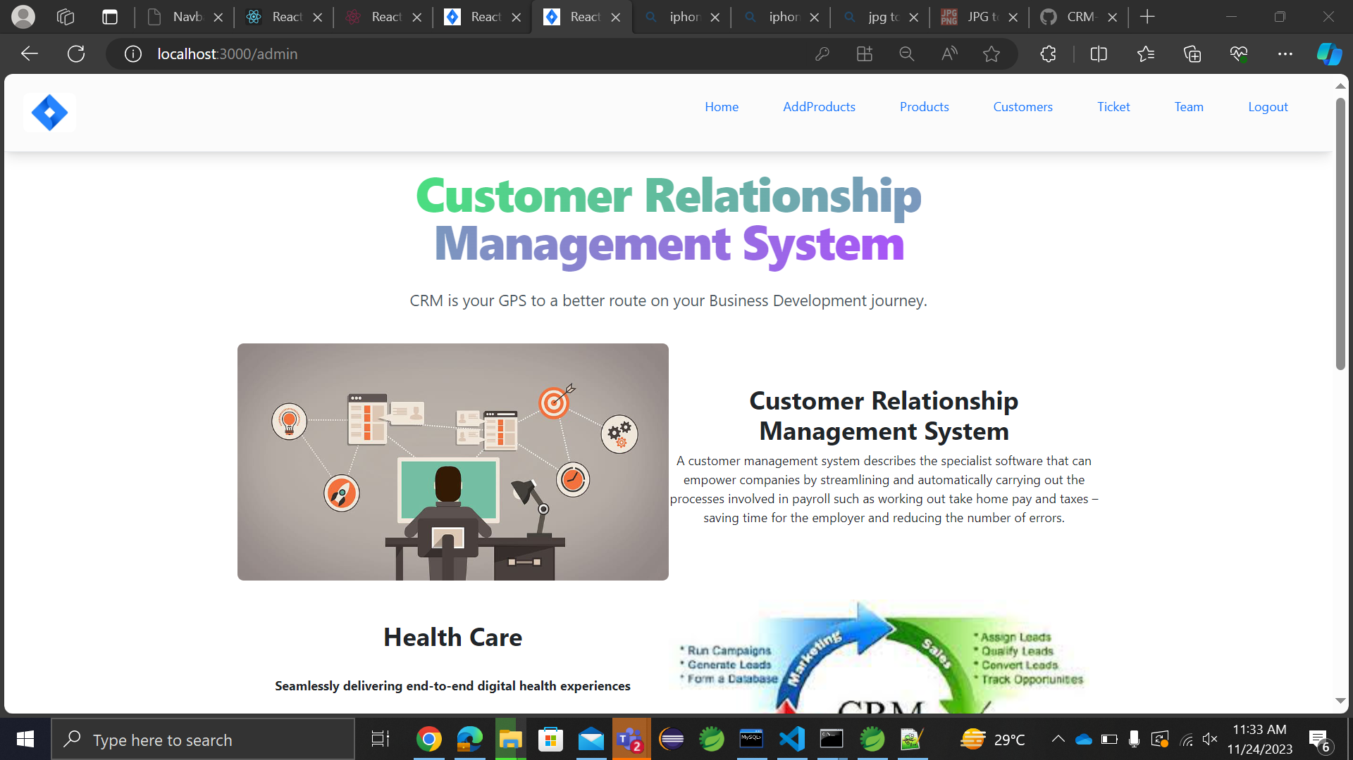
OUTPUT SCREENS

Slide 13

OUTPUT SCREENS

Slide 14
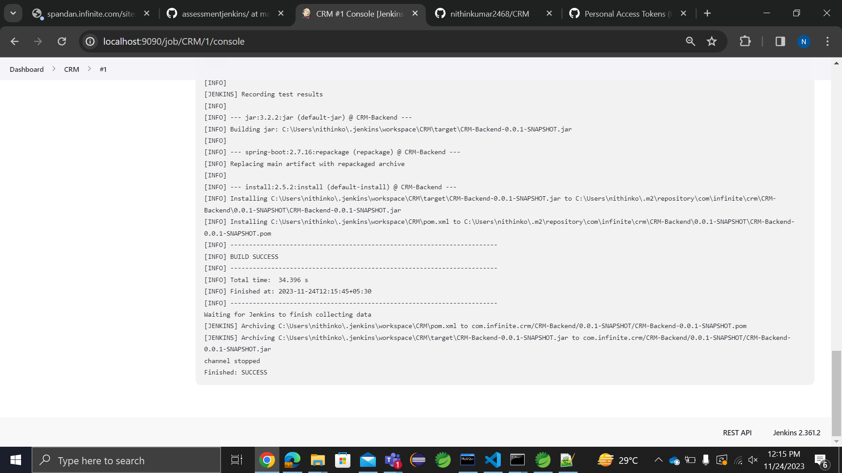
JENKINS BUILD

Slide 15
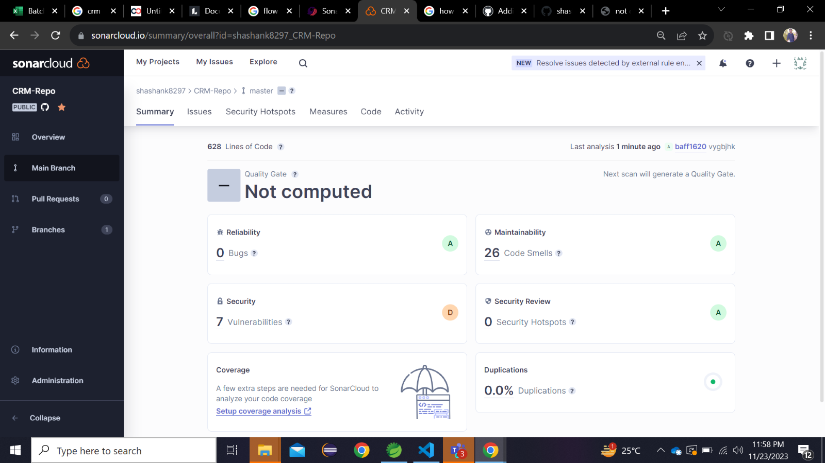
SONARQUBE REPORT

Slide 16
CONCLUSION
Customer Relationship Management (CRM) has become a pivotal strategy for businesses aiming to build and maintain strong relationships with their customers.​
The implementation of CRM systems has enabled organizations to streamline their processes, enhance customer interactions, and gain valuable insights into customer behaviors and preferences.​
The goal is to improve customer service relationships and assist with customer retention and drive sales growth.

Slide 17
FUTURE SCOPE
The future of CRM holds several exciting possibilities:-​
AI and Automation
Personalization
Blockchain for Security
Emphasis on Customer Experience
Cloud-Based Solutions

Slide 18


